Slide 1
CSET335L (Deep Learning)
Lecture 10: Bias Variance
Deepika Vatsa

Slide 2
Outline
Regularization techniques: Drop out, Early stopping
Bias
Variance

Slide 3
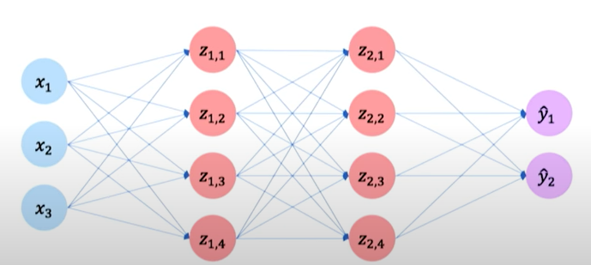
Regularization: Drop Out
Very popular regularization method in deep learning is drop out
During training, randomly select some activations in hidden layers and set it to 0.
Notes:
So we are telling our network to not rely on those neurons too much.

Slide 4
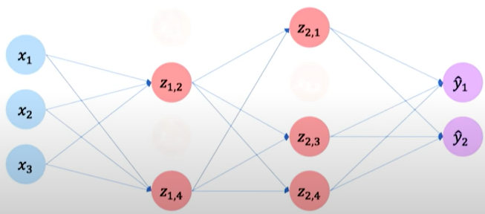
Regularization: Drop Out
Lets say if drop out is 50% (dropping 50% activation neurons), then at different iterations, we randomly select different 50% activations to drop.
Notes:
It helps in learning different pathways in our network which will further help to generalize the model.

Slide 5
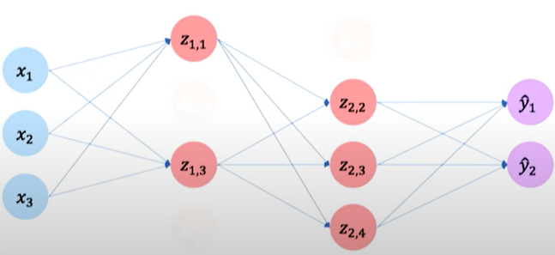
Regularization: Drop Out
Lets say if drop out is 50% (dropping 50% activation neurons), then at different iterations, we randomly select different 50% activations to drop.
Notes:
It helps in learning different pathways in our network which will further help to generalize the model.

Slide 6
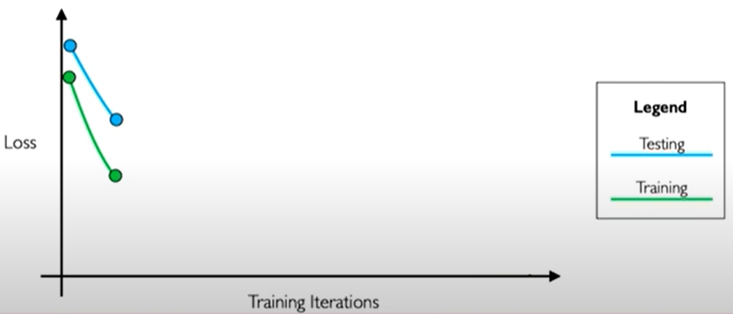
Regularization: Early Stopping
Overfitting also happens when there is too much training.
Solution: Stop training before we have a chance to overfit.
Notes:
We know in overfitting, our model performs very good on training data but very badly on our test data. So in this case of regularization, what we do is we create a small set from training and call it our example test set. So initially our model works good on both training and test set (that is loss decreases), but after certain num of iterations it increases for test set while decreases for the training set. The pattern of divergence continue for further training iterations. We will figure out a point where the test loss is minimum and we will stop there. That would be the best model for generalization.

Slide 7
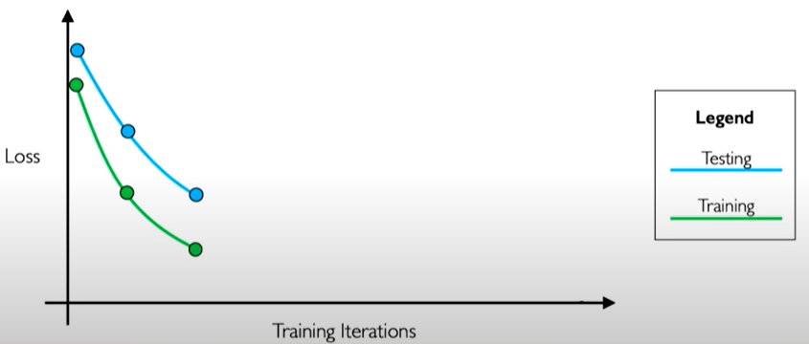
Regularization: Early Stopping
Stop training before we have a chance to overfit
Notes:
We know in overfitting, our model performs very good on training data but very badly on our test data. So in this case of regularization, what we do is we create a small set from training and call it our example test set. So initially our model works good on both training and test set (that is loss decreases), but after certain num of iterations it increases for test set while decreases for the training set. The pattern of divergence continue for further training iterations. We will figure out a point where the test loss is minimum and we will stop there. That would be the best model for generalization.

Slide 8
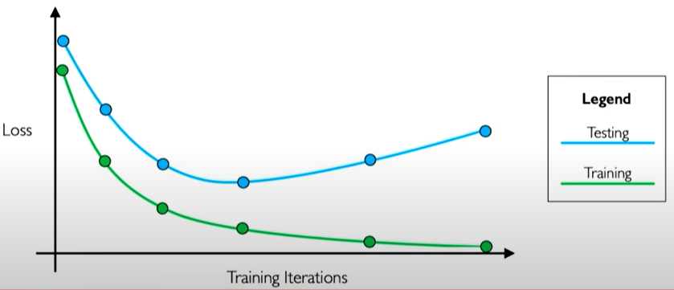
Regularization: Early Stopping
Stop training before we have a chance to overfit
Notes:
We know in overfitting, our model performs very good on training data but very badly on our test data. So in this case of regularization, what we do is we create a small set from training and call it our example test set. So initially our model works good on both training and test set (that is loss decreases), but after certain num of iterations it increases for test set while decreases for the training set. The pattern of divergence continue for further training iterations. We will figure out a point where the test loss is minimum and we will stop there. That would be the best model for generalization.

Slide 9
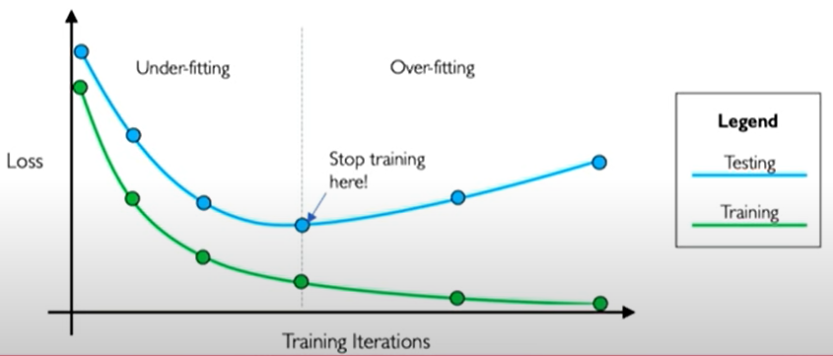
Regularization: Early Stopping
Stop training before we have a chance to overfit
Notes:
We know in overfitting, our model performs very good on training data but very badly on our test data. So in this case of regularization, what we do is we create a small set from training and call it our example test set. So initially our model works good on both training and test set (that is loss decreases), but after certain num of iterations it increases for test set while decreases for the training set. The pattern of divergence continue for further training iterations. We will figure out a point where the test loss is minimum and we will stop there. That would be the best model for generalization.

